Slide 1


Cockle Outplanting feasibility project

Slide 2
Project Title:
Examining the feasibility of culturing the basket cockle Clinocardium nuttallii utilizing suspended culture.
Goals:
Refine hatchery procedures
Compare hatchery growth and survival to FLUPSY.
Evaluate growing strategies for out planting timing spring vs. fall

Slide 3
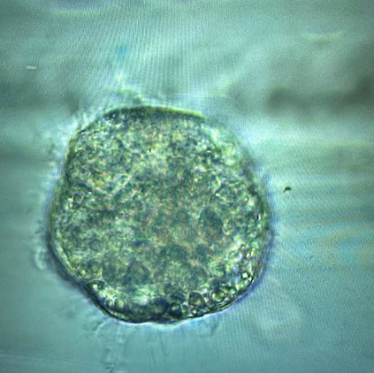
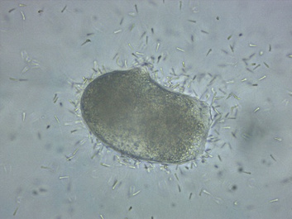
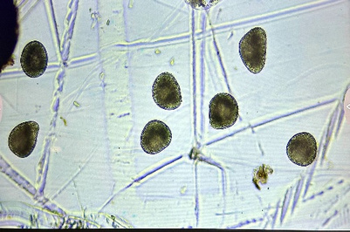
Egg Fertilization and Development
Fertilizing eggs
Early larvae
Trochophore

Slide 4
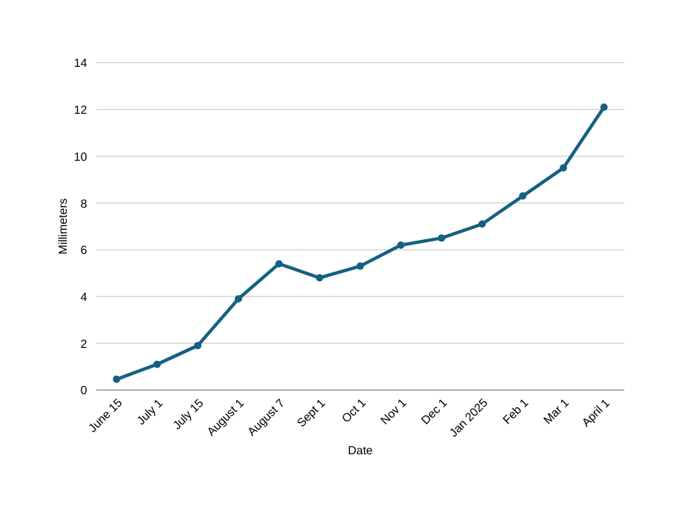
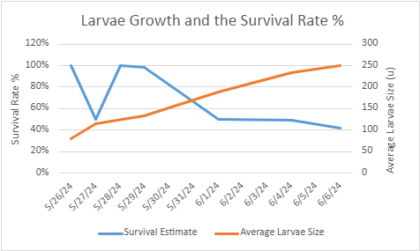
Larval growth and Survival, Juvenile Growth

Slide 5
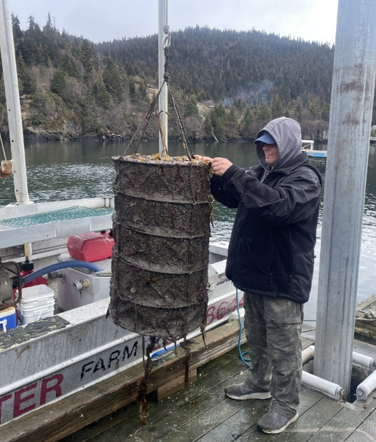
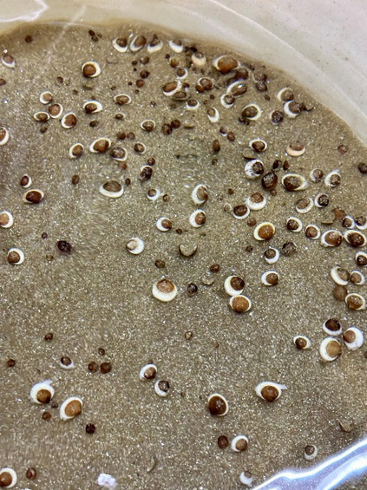
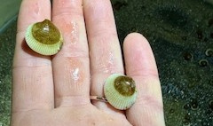
Hatchery Produced Seed Overwintered in Hatchery
Cockles in hatchery silo
Growth spurt "popping'
Sean Crosby KSMA grow out

Slide 6
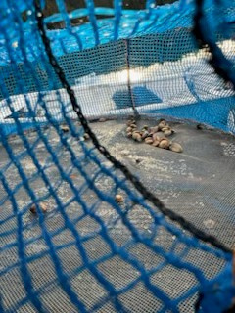
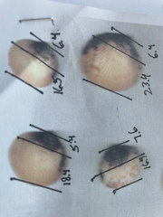
Grow out Results August 2025
Growth in nets-measurements used for extrapolation
Cockles in lantern nets

