Slide 1


Hatchery cultivation of the Pacific razor clam (Siliqua patula)
Lead Entity: Alutiiq Pride Marine Institute

Slide 2
Project Goals:
1) Broodstock collection and maturation
2) Examine elevated temperatures to accelerate larval development and juvenile rearing
3) Examine substrate preferences
4) Evaluate long term rearing strategies
5) Education and Outreach

Slide 3
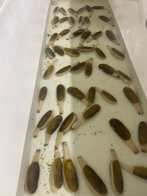
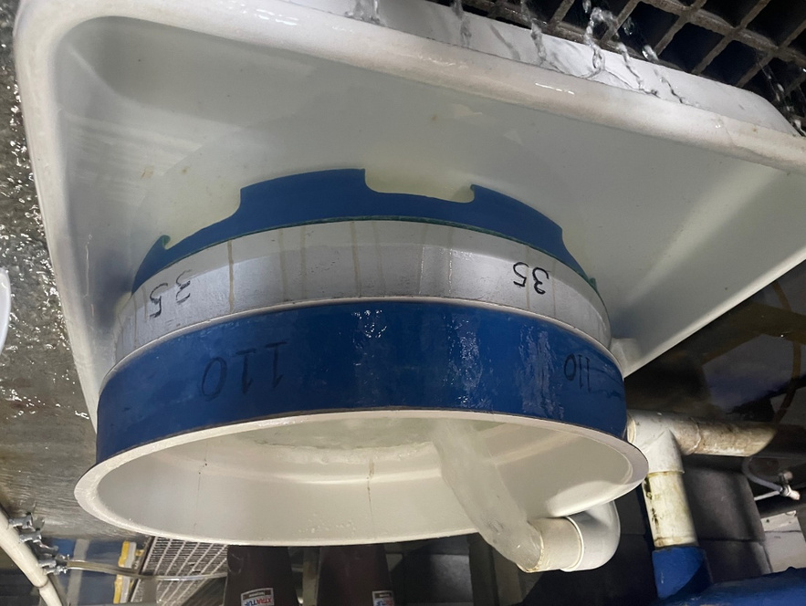
Broodstock Tank, Harvesting spawn

Slide 4
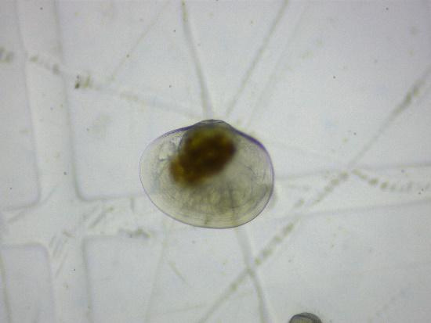
Razor Clam Larvae Day 14

Slide 5
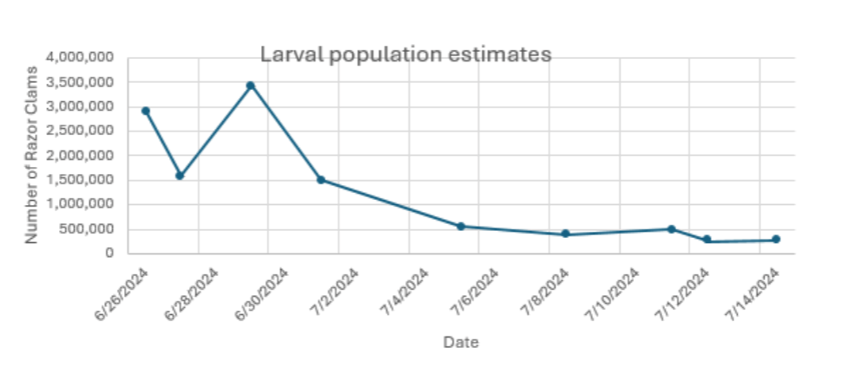
APMI Razor Clam spawn data

Slide 6
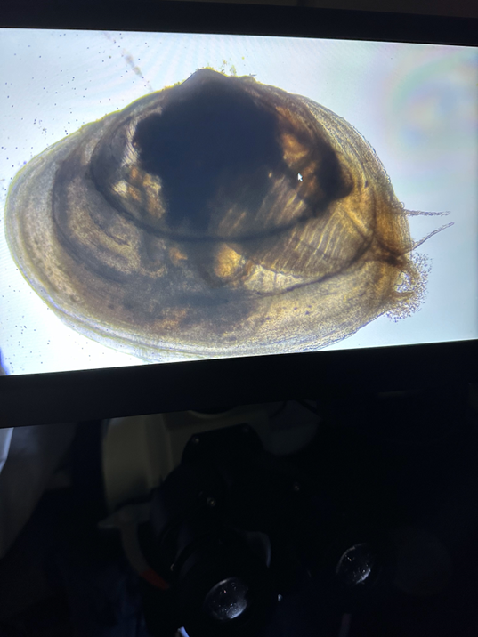
Razor clam juvenile Day 25 2mm

Slide 7
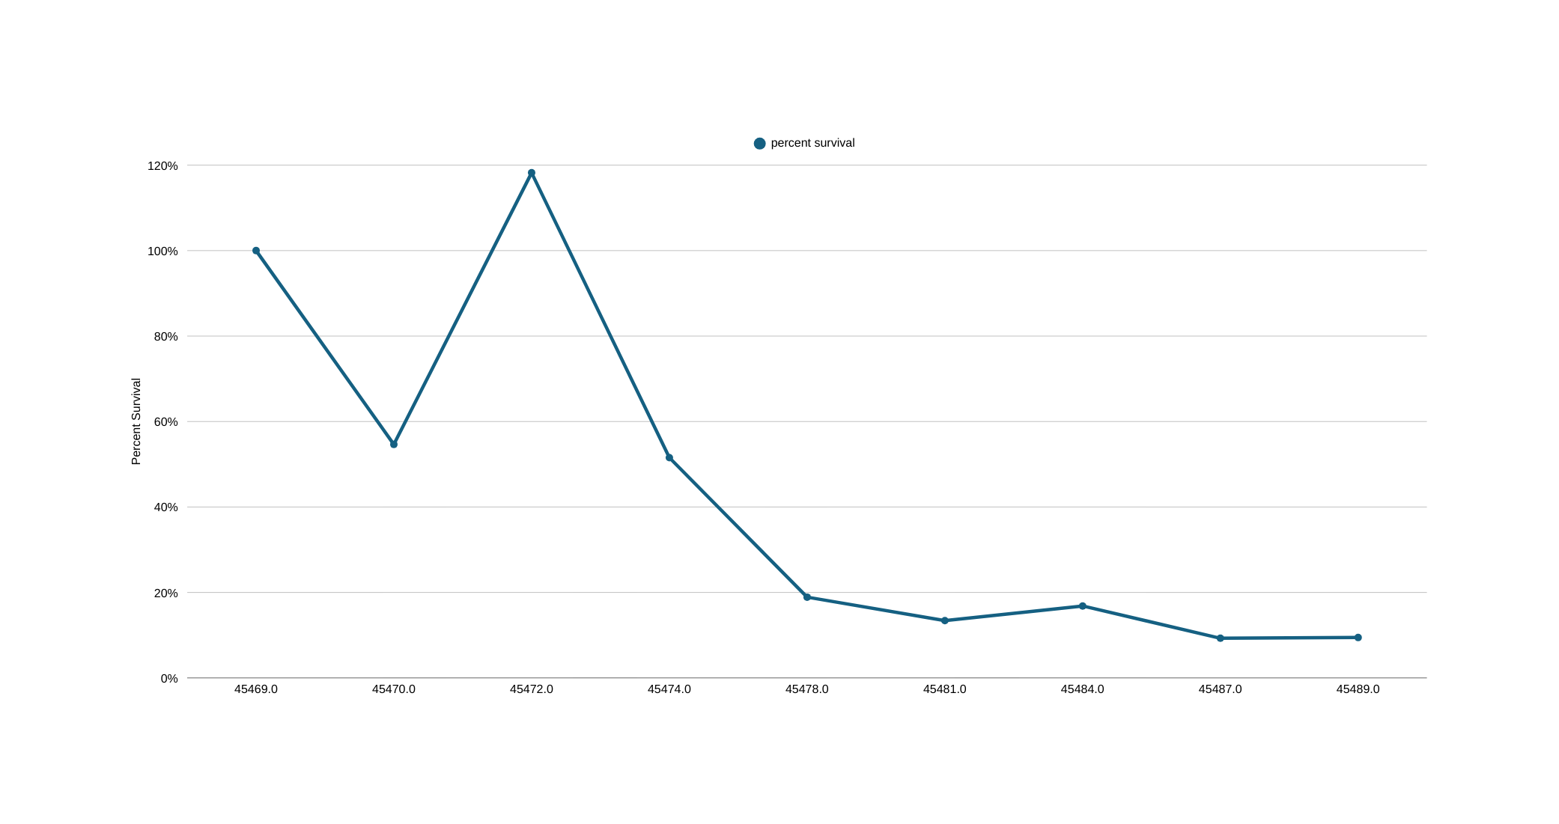

Slide 8
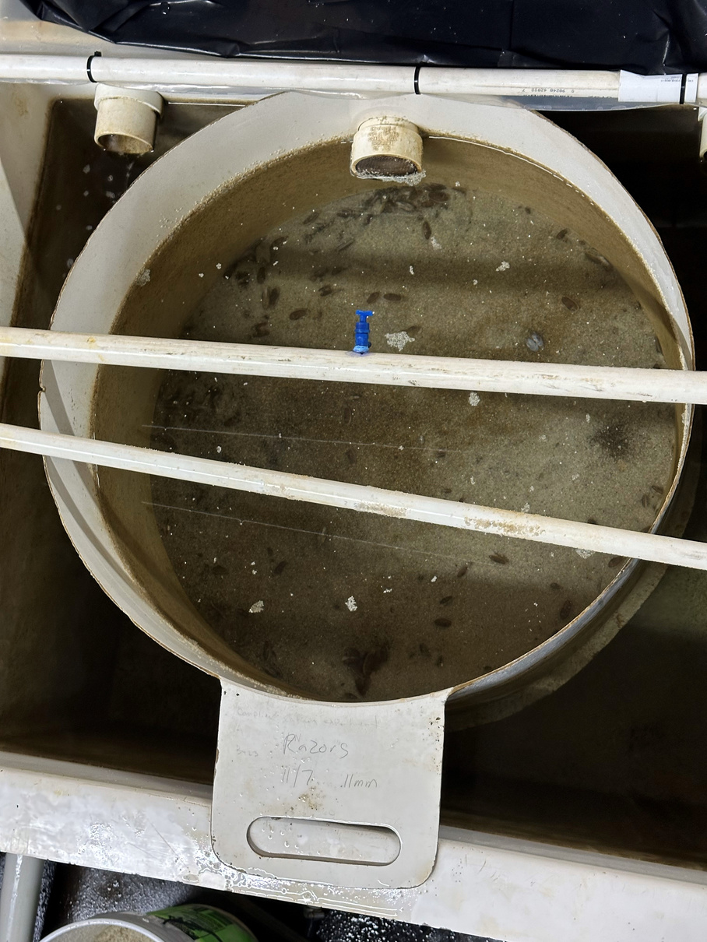
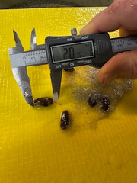

Slide 9
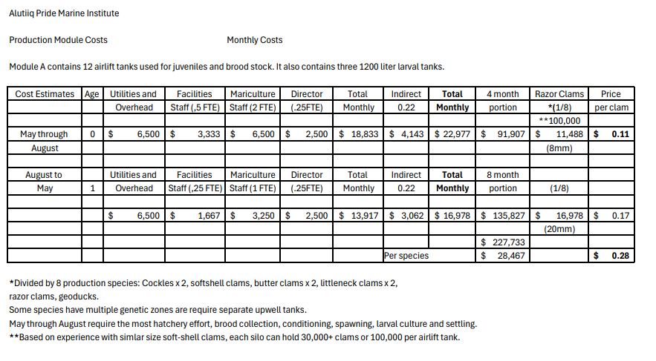
Production Cost Estimates

