Slide 1


Alaska Mariculture Cluster
Governance Body Update
January 2026
Presented by Noah Enelow, Ecotrust
Notes:
Mariculture Photo Contest folders:
Mariculture Photo Contest 2025
Mariculture Photography Contest Feb 2024

Slide 2

1
2
3
Recap of Recent Work
Preview of Upcoming Work
Q&A (if time)
Notes:
Memo text: P2 - AMC Eval Update Memo DRAFT TEXT

Slide 3
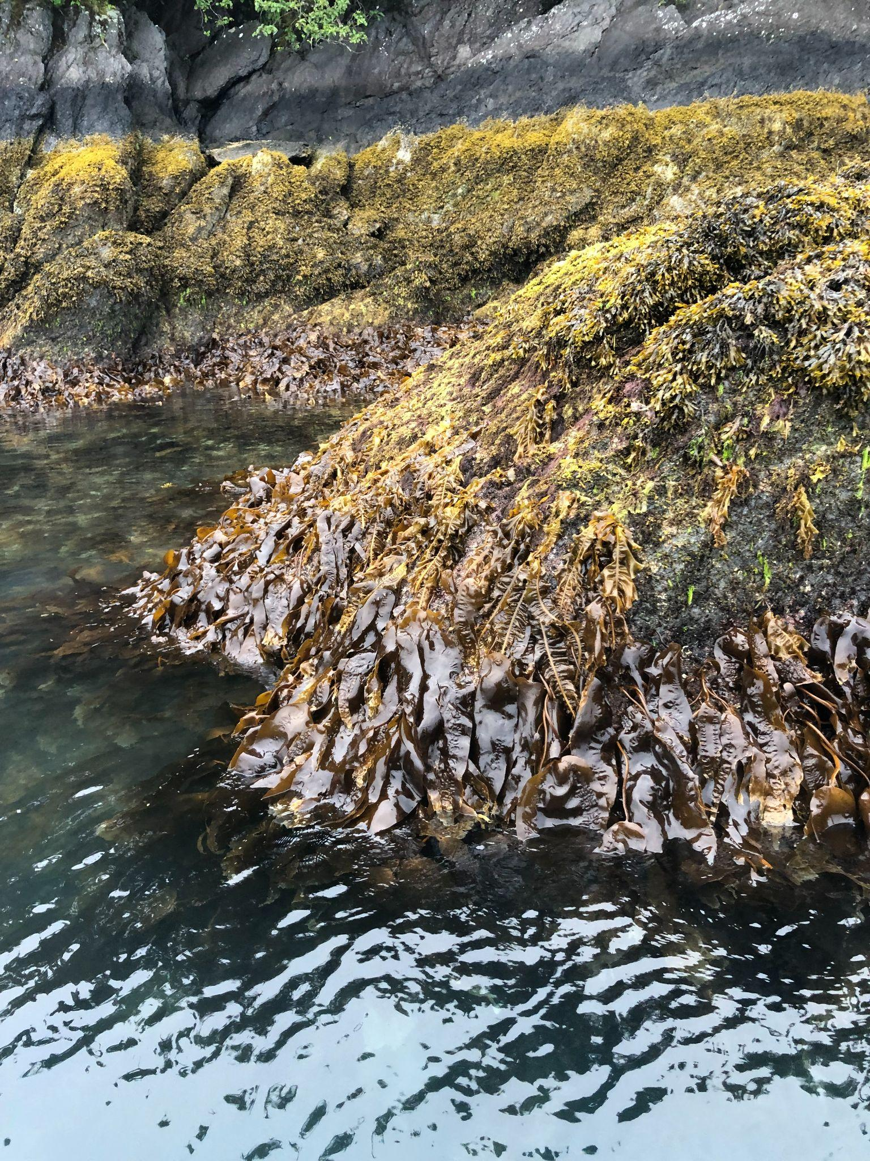
Recap of Recent Work
Webinar
  November 20, 2025; hosted by AMA
  Webinar: AMC Grant Evaluation with Ecotrust - Alaska Mariculture Cluster
Website
  Grant Evaluation - Alaska Mariculture Cluster
  SEC hosting it - thank you Charlie and Abigail!
  Updated regularly
Biodiversity in Alaskan Kelp.
SOURCE: SKYE STERITZ / AMA

Slide 4
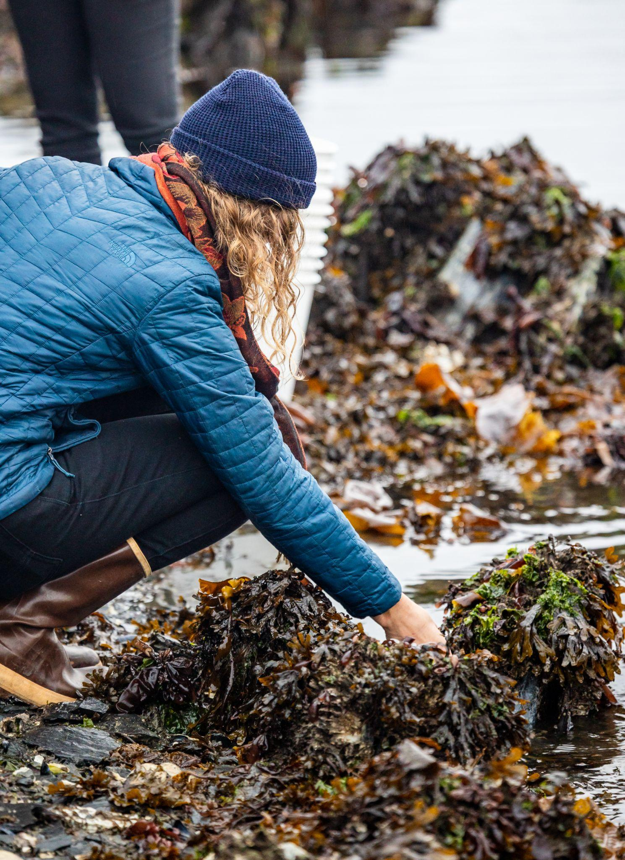
2. Preview of Upcoming Evaluation Work 2026
Focus Groups
  Completed: Kodiak
  Planned: PWS, Kenai, Southeast (Jan - Feb 2026)
Evaluation Report
  Will cover all AMC activities 2024-2025
  Complete by Mariculture Conference
Poster at Mariculture Conference of Alaska
  March 10-12, Anchorage
  I will be available for in-person meetings
2024-2026 Evaluation Report - TBD
Intertidal Zone
SOURCE: CARTY / AMA

Slide 5
3
Q&A (if time)

Slide 6

Thank you for joining us!
ecotrust.org | @ecotrust
Notes:
Ending / Landing slide

