Slide 1
Green Energy in Mariculture project updates
Chandler Kemp
University of Alaska Fairbanks
January, 2026

Slide 2
Project components
On water efficiency
Deck gear
Propulsion
Systems
On shore efficiency
Stabilizing
Drying
Chemical
Blanch and freeze
hatchery

Slide 3
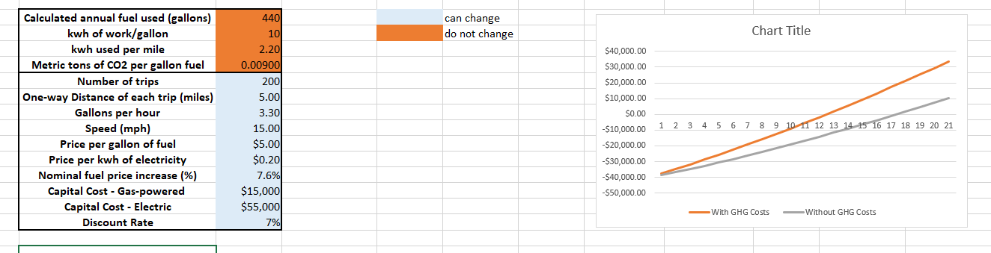
Current work: electric propulsion analysis with Raincoast Data

Slide 4
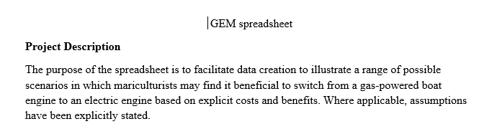
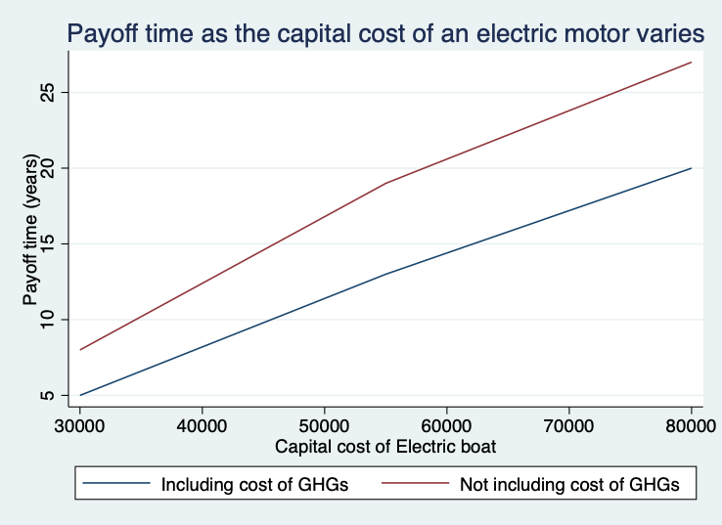
An internal white paper on the model is being adapted for publication.

Slide 5
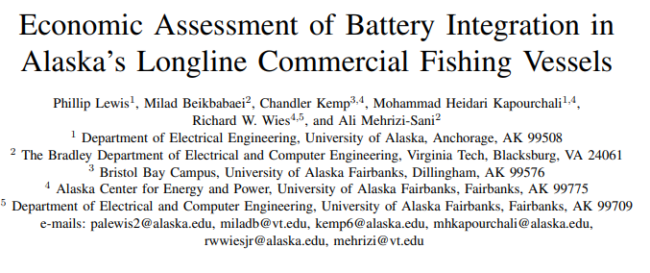
This work builds on a publication by graduate student Gus Lewis addressing electric propulsion on fishing vessels.
Further work led by Gus modeling dynamic loads on vessels is under review.

Slide 6
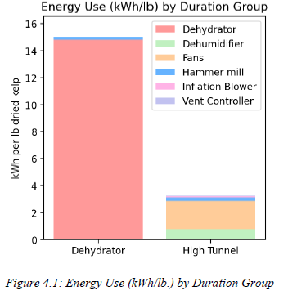
Detailed analysis of electric loads for processing in Homer was finalized.

Slide 7
Additional ongoing work
Modeling time of use and potential solar integration for kelp processing led by Mohammad Heidari
Literature review, including join innovation projects and publications from abroad
Integration of internal reports into comprehensive green energy plan

Slide 8
Next steps
Developing report for review
Outreach planning for sharing project outcomes

